Slide 1
Renewable or non-renewable resources
Which resource is better and why.
Advantages & disadvantages
Compare & contrast

Slide 2
What are renewable and non-renewable resources
Renewable resources are resources that can grow back or you won’t run out of. Non-renewable resources are resources that will eventually run out if you use too much or all of it.

Slide 3
Some renewable resources are…
Biomass - Biomass is plant or animal material used as fuel to produce electricity or heat
Hydropower - Hydropower or water power is power derived from the energy of falling or fast-running water, which may be harnessed for useful purposes
geothermal - Geothermal energy is the thermal energy generated and stored in the Earth
Wind - Wind energy or wind power describes the process by which wind is used to generate electricity
solar - Solar energy is radiant light and heat from the Sun that is harnessed using a range of ever-evolving technologies such as solar heating, photovoltaics, solar thermal energy, solar architecture, molten salt power plants and artificial photosynthesis

Slide 4
Some non-renewable resources are…
oil - Crude oil is a nonrenewable fossil fuel. Distillation separates the by-products of crude oil
natural gas - Natural gas, is a naturally occurring hydrocarbon gas mixture consisting primarily of methane, but commonly including varying amounts of other higher alkanes, and sometimes a small percentage of carbon dioxide, nitrogen, hydrogen sulfide, or helium
Coal - Coal is a combustible black or brownish-black sedimentary rock, formed as rock strata called coal seams. Coal is mostly carbon with variable amounts of other elements; chiefly hydrogen, sulfur, oxygen
nuclear - Nuclear power is the use of nuclear reactions that release nuclear energy to generate heat

Slide 5
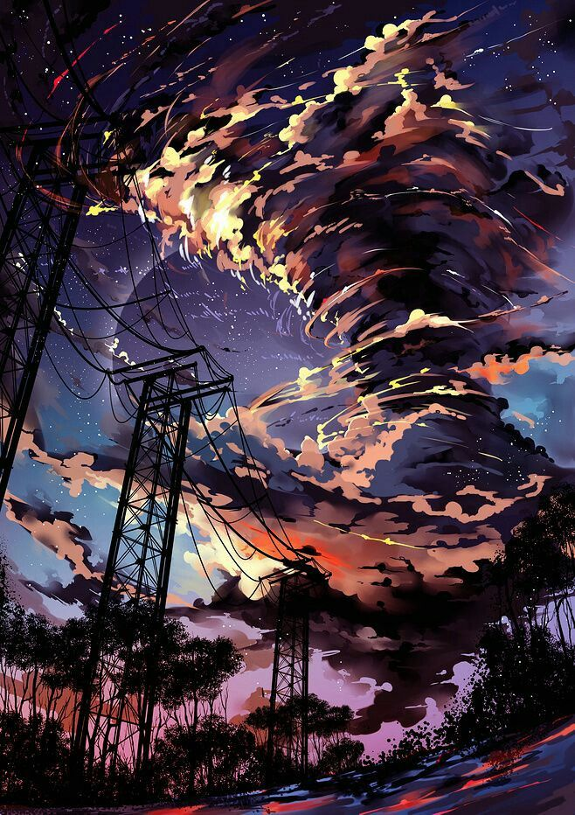
Advantages of renewable resources
Renewable energy won't run out.
Maintenance requirements are lower.
Renewables save money.
Renewable energy has numerous health and environmental benefits.
Renewables lower reliance on foreign energy sources.
Higher upfront cost.
Intermittency.
Storage capabilities.

Slide 6
Advantages of non-renewable resources
Non-renewable sources are cheap and easy to use.
You can use small amount of nuclear energy to produce large amount of power.
Non-renewable have little or no competition at all.
They are considered as cheap when converting from one type of energy to another.

Slide 7
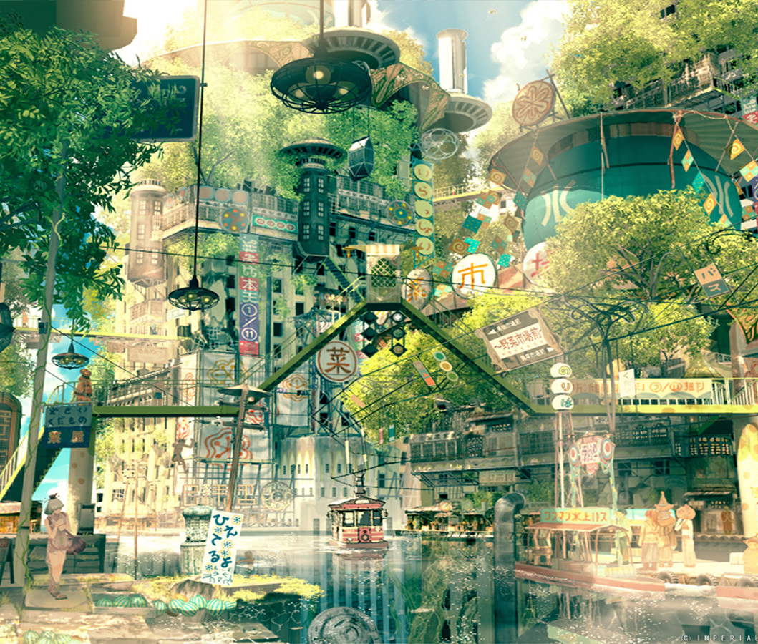
Disadvantages of renewable resources
The Electricity Generation Capacity is Still Not Large Enough.
Renewable Energy Can be Unreliable.
Low-efficiency Levels.
Requires a Huge Upfront Capital Outlay.
Takes a Lot of Space to Install.
Expensive Storage Costs.
Not Always a Commercially-viable Option.
It Still Generates Pollution.

Slide 8
Disadvantages of non-renewable resources
Fossil fuels took millions of years to form in the Earth's crust and can never be replaced once they have been used.
When fossil fuels burn, they release carbon dioxide into the atmosphere.
Coal and gas also release Sulphur dioxide gas when they are burned.

Slide 9
Thank you! Facts and pictures from google. (o゜▽゜)o☆

